Slide 1

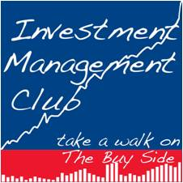
Spring 2012 Stock Pitch Competition
23 February, 2012

Slide 2
Agenda
1 | About the Stock Pitch Competition
2 | Student Investment Fund update
3 | Competition’s Judges
4 | Stock Pitch Finalists
5 | Student Presentations
6 | Judges’ final decision
Autumn 2011 Stock Pitch Competition
Spring 2012 Stock Pitch Competition
Spring 2012 Stock Pitch Competition

Slide 3
About the Stock Pitch Competition (I)
Objectives
Select stocks for the Student Investment Fund
Allow students to practice a fundamental skill for Investment Management and Investment Management interviews
Description
  Held twice a year (Spring/Autumn)
  5 finalists chosen to present their ideas to judges from sponsoring firms
  Top placed students will represent the School at the inter business school Alpha Challenge held in the US
Autumn 2011 Stock Pitch Competition
Spring 2012 Stock Pitch Competition

Slide 4
About the Stock Pitch Competition (II)
Rules
  Participants have to select a stock that represent a good investment opportunity and put together a convincing recommendation
  All participants have to submit a one-page summary of their recommendation using a pre-determined template for review by the judges
  Company must be listed on one of the following exchanges:
      USA: NYSE, NASDAQ, AMEX
      Canada: TSE, Canadian Venture Exchange
      Europe: LSE, Paris Bourse, Deutsche Bourse, Amsterdam SE, Madrid SE, Brussels SE, Swiss Exchange, Stockholm SE
      Asia: Australia SE, Hong Kong SE, Singapore SE
  Market capitalisation must be over $50m
  Daily Liquidity/Volume: >$250k (3mo avg.)
  Finalists will be invited to pitch their idea in front of the judges at the final round

Slide 5
Agenda
1 | About the Stock Pitch Competition
2 | Student Investment Fund update
3 | Competition’s Judges
4 | Stock Pitch Finalists
5 | Student Presentations
6 | Judges’ final decision

Slide 6
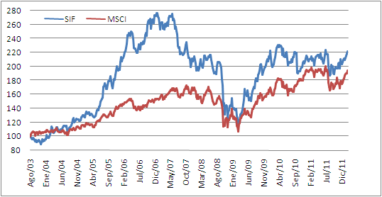
Student Investment Fund update (I)
Performance update as of 20th February 2012
 | Since inception | 1 Year | YTD
SIF | 109.5% | -2.7% | -0.03%
MSCI All Country World Index | 86.8% | -7.3% | 3.2%
Over/Under-performance | 22.7% | 4.7% | -3.2%

Slide 7
Student Investment Fund update (II)
Portfolio Composition: GBP 276,880 in equities and GBP 3,972 in cash

Slide 8
Agenda
1 | About the Stock Pitch Competition
2 | Student Investment Fund update
3 | Competition’s Judges
4 | Stock Pitch Finalists
5 | Student Presentations
6 | Judges’ final decision

Slide 9

Competition’s Judges
Daniel M. Brocklebank
Orbis
Mr. Brocklebank joined Orbis in 2002 and is now a Director of the Company. He has primary responsibility for the UK‐based team of global sector investment analysts and has previous experience at Arthur Andersen. Master of Arts (Honours) in Politics, Philosophy and Economics (Brasenose College, University of Oxford), Chartered Accountant, CFA.
Jon Guinness
Fidelity Worldwide Investment
Mr. Guinness joined Fidelity in of 2005 as an MBA intern and re-joined Fidelity in Autumn 2006, upon graduating from LBS. He has covered UK Non-Food Retail, UK Housebuilders and Builders, and Large Cap Telecoms, and was a TMT Team Leader..Now Jon covers US Consumer companies for the Global Team and has previous experience at Bain. He has a Masters Degree from LSE and graduated in Economics from Cambridge University.
Alexandra Perricone
Sanford C. Bernstein
Alexandra Perricone joined Sanford C. Bernstein in 2009 as Associate Director of European Research. Ms Perricone started her career in fixed income sales at Nomura and then moved into equity research, first at Dresdner Kleinwort and then at HSBC. In 2006, she joined Lehman Brothers to run the Graduate Training and Development Programme for the Investment Banking Division. Immediately prior to joining Sanford C. Bernstein, Ms Perricone was co-Head of Soft Skills Training for Moody's Analytics. Alexandra graduated in Modern Languages at Oxford University.

Slide 10
Agenda
1 | About the Stock Pitch Competition
2 | Student Investment Fund update
3 | Competition’s Judges
4 | Stock Pitch Finalists
5 | Student Presentations
6 | Judges’ final decision

Slide 11
Stock Pitch Finalists
JP Monforte
MIF 2012
Dell Inc.
Samuel Kim
MBA 2012
Lifestyle International Holdings Ltd
Yabing Wu
MiM 2012
Altria Group Inc.
Harshita Rawat
MBA 2013
SanDisk Corporation
Stelios Fragos
MBA 2013
Cheniere Energy Inc.

Slide 12
Agenda
1 | About the Stock Pitch Competition
2 | Student Investment Fund update
3 | Competition’s Judges
4 | Stock Pitch Finalists
5 | Student Presentations
6 | Judges’ final decision

Slide 13

LBS Stock Pitch 2012
JP Monforte

Slide 14
Dell in a nuthsell (i)
Founded in 1984 by Michael Dell
Market cap of $ 32.6 billion
Dell sells desktops, notebooks, servers, storage, services, and software and peripherals to enterprises and consumers across the globe

Slide 15
Dell in a nutshell (ii)
Source: Dell

Slide 16
Historical Performance
Source: Factset

Slide 17
Market share
Source: Dell and IDC

Slide 18
Competitors
Global competitors
  HP, Lenovo, Acer and Asus
  Dell is number 3
  Together they control 60% of the global PC market
US market represents 50% of Dell’s business
  HP, Apple, Toshiba and Acer
  Dell is number 2
  Together they control 77% of the US PC market

Slide 19
Business Strenghs
“Utility” model: computers/servers/data storage have become a necessary tool to run a business, making it a non-discretionary expenditure by companies
Leadership: desktops and laptops have become a commodity, making scale a crucial component of profitability.
Oligopoly: the global market for desktop is highly concentrated among few players, which makes the market more rational in pricing and supply. The top 5 players have approximately 60% of market share worldwide and 77% in the US.
Customer service: unlike its peers Dell has since its birth employed a direct sales process which gives it a competitive edge.
Balance sheet flexibility: the large net cash position of Dell provides it with many shareholder value-enhancing opportunities such as share buy-back, dividends or acquisitions.

Slide 20
Financial Assesment

Slide 21
Peers
Source: Bloomberg

Slide 22
Risk and mitigations
Risk | Mitigation
Large net cash position (~25% of market cap) could prompt the company to invest poorly Dell recently created a new software group, which can be seen as a sign for M&A activity | Part of the cash is held at overseas subsidiaries which limits the company’s hability to misuse it Company has been engaging in share buybacks (target for 2012 is ~700 mio)
US tax laws affect the companies’ ability to repatriate excess cash | Current economic scenario is pushing companies to lobby US congress to repatriate the cash
Technological innovations could jeopardize the company’s business | The PC market is more mature and less volatile then other tech segments
Weak economic environment could promote greater competition in the market | The concentration of the industry should enable players to maintain profitability

Slide 23
Appendix

Slide 24
Source: Bloomberg

Slide 25
IMC Stock Pitch Competition
Lifestyle International Holdings Ltd
Samuel Kim (MBA2012)
23 February 2012

Slide 26
Executive Summary (HK$21, TP HK$26, Rating ‘Buy’)
  My recommendation
  Buy: Lifestyle International Holdings Limited (HK$34.2 bn MC)
    TP: HK$26, 31% upside from current (including dividend yield)
    My target price is based on SOTP and DCF analysis, at an implied 2012E P/E multiple of 18x on my numbers which are 16% above consensus.
    Currently trading in line with peers with similar ROE
In the short-term, Lifestyle is a play on high-end consumption and rise in Chinese tourists’ spending in HK
In the long-term, Lifestyle’s growth will be driven by the emergence of department stores as one of the key retail formats in China and management’s ability to capture the upside. Appreciating value of owned store properties is an added bonus
I expect China will replicate the Korea/Japan story - consumption in department stores will enter the accelerated growth phase when China’s GDP per capita grows from US$10K to 20k (sales growth +10% CAGR over 10 years, market cap 5-10x)
I believe the durability of growth potential and margin expansion are not fully reflected in the current valuation
1

Slide 27
Investment Rationale and Risks
Investment Rationale
  Rise in disposal income of China’s affluent middle/upper class will lead to a double digit growth in topline in the foreseeable future (~15% topline / ~20% EPS growth)
  Strong franchise with sound retail management and consistent execution (Dominant market position in HK, negative working capital and sound capital allocation)
  Operating leverage from asset-heavy model will lead to continued margin expansion (operating margin trending up towards 18-19%)
  Stable, prudent expansion strategy with greater reliance on organic growth (strong balance sheet / smaller margin dilution from expansion compare to peers)
2

Slide 28
Investment Risks / Concerns
Investment Risks
  Susceptibility to deterioration in HK retail environment
    Risk Mitigant – I expect HK will continue to attract Chinese tourists due to its concentrated and high-end retail environment with considerable price difference to mainland (~30%)
  Intensifying competition and potential oversupply in China
    Risk Mitigant – Lifestyle’s management has been prudent in its expansion plan and have careful executed its entry strategies in China (i.e. Shanghai). I believe its management will continue to be patient and opportunistic when expanding in China
  Increase in land costs leading to longer payback periods.
    Risk Mitigant – Management’s track record of identifying good land and development execution gives some comfort that its new stores will breakeven in a reasonable time frame (2-4 years)
  Decrease in value of its commercial properties
    Risk Mitigant – Value in its HK stores will hold. Its Chinese stores were bought much earlier (Shanghai before 2004) and mainly under JV arrangement (50:50)
3

Slide 29
Industry Conclusion and Stock Picking Framework
I am positive on the sector – however, important to pick stocks based on the business model
HK Department Store Sector:
  Stable growth story in an established market (9.4% CAGR 2003-2010)
  Concentrated market with top 6 names with +75% M/S (Lifestyle with ~22% M/S)
  Influx of Chinese tourists (12.6% CAGR 2005-2010) and increasing demand for luxury goods will drive topline and margins
  Good environment for incumbents
China Department Store Sector:
  Strong growth (12.4% CAGR 2003-2010) and fragmented market with top 10 players with ~15% M/S
  Government policy directed to promote consumption
  Polarized growth in disposable income – driver behind luxury retailers’ +30% y-o-y growth
  Expect to follow Korea/Japan department store consumption/growth pattern
Stock Picking: I prefer department stores with -
  Asset Heavy over Asset Light models
  Prudent Expansion over Rapid Expansion strategies
  Regional Concentration over National Coverage
4

Slide 30
Evidence Behind Durability of Growth - Korea/Japan Case Study
China’s GDP per Capita (2011) is ~$8,400. I expect strong and sustained growth in department stores sector when going from $10k to $20k
Top Retailers by Market Cap
Department stores in a sweet spot as GDP per capita rose from 10k to 20k
Similar to Japan’s case in 1980’s, department stores are Korea’s main retail format as GDP per capita goes from 10k to 20k
5

Slide 31
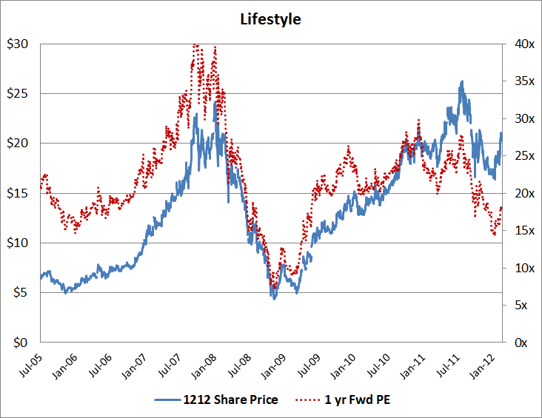
Lifestyle International (HK: 1212) (HK$21, TP HK$26, Rating ‘Buy’)
HK/China Department Store
Overview
Lifestyle is a HK based department store operator of mid-high to high-end department stores in Hong Kong and China.
The group currently operates 2 stores in HK under the SOGO brand and has expanded its stores portfolio to 3 in China under the Jiuguang brand. In 2010, HK contributed to 73% of total group sales and over 85% of group operating profit.
Approximately 25-30% of HK sales are generated from cross-border Chinese tourists.
Lifestyle adopts an asset-heavy model and focuses on developing 1 flagship store every 2-3 years.
CEO owns +70% of the company’s shares
Fwd PE
Ave: 21.6x
Ave (excl.GFC): 23.1x
Min: 7.1x
Max: 42.8x
Valuation
TP HK$26 (31% upside incl. div) based on:-
  SOTP: HK$28 (implying Fwd 2012E PE of 20.6x)
  DCF: HK$25 (implying Fwd 2012E PE of 18.4x)
  Multiple: HK$27 (applying 20x Fwd 2012 PE).
  Potential Downside – 16% downside if Chinese economy slows down below 7.5%
6

Slide 32
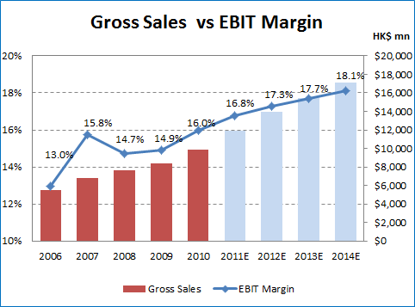
Lifestyle International (HK: 1212) (HK$21, TP HK$26, Rating ‘Buy’)
Stable growth and margin expansion
Key drivers of the revenue are growth in ticket size in HK and volume/ticket size growth in China
Chinese tourists in HK are trading up to big ticket items (jewelry, watches and luxury brands) and this will continue to contribute growth in HK while China stores will benefit from volume growth, as well as increasing demand for luxury goods
Lifestyle experienced a stable growth on the back of strong performance of its flagship store and ramp-up of sales in its China stores
Margin expansion is expected as:
  Movement towards higher ticket item
  Sales ramp-up in China stores will have positive contribution to earnings
7

Slide 33
Lifestyle International (HK: 1212) (HK$21, TP HK$26, Rating ‘Buy’)
Industry leading operational efficiency and sound capital allocation
Lifestyle has low inventory days and has negative working capital
Distributes ~30% of FCF from operation as dividend and share buyback
On 2-3 year cycle, it spends most of FCF from operation for expansion of new stores
Lifestyle outperformed its peers in operational efficiency due to:-
  Strong bargaining power and merchandising skills
  Smaller number of stores and prudent expansion strategy
  Self ownership of operating properties
  Despite its asset heavy model, Lifestyle has above industry average ROCE (13% vs. 11%)
8

Slide 34
Lifestyle International (HK: 1212) (HK$21, TP HK$26, Rating ‘Buy’)
Valuation - SOTP
SOTP used to carve out the value attributing to its department store retail operations, and value of its properties and other investments
9

Slide 35
Lifestyle International (HK: 1212) (HK$21, TP HK$26, Rating ‘Buy’)
Valuation - DCF
Base Case
  HK
    Continued current retail environment
    Topline growing at CAGR 10% p.a. 2011-2015
  China
    Continued GDP growth at ~10%
    Topline growing at CAGR 15% p.a. 2011-2015
  EBIT Margin expands to ~18%
Bull Case
  HK
    Continued current retail environment
    Topline growing at CAGR 13% p.a. 2011-2015
  China
    Continued GDP growth at ~10%
    Topline growing at CAGR 18% p.a. 2011-2015
  EBIT Margin expands to ~20%
Bear Case
  HK
    Slowdown in 2H2012-2013
    Topline growing at CAGR 3% p.a. 2011-2015
  China
    Hard landing (GDP growth at below 7.5%)
    Topline growing at CAGR 5% p.a. 2011-2015
  EBIT contracts to expands to ~15%
1
2
3
10
Notes:
On DCF, I tried to see how the stock would value under different economic scenarios.
I believe as long as China does not come to a hard landing (GDP growth below 7.5%), the stock will perform well in both near term and long term

Slide 36
Lifestyle International (HK: 1212) (HK$21, TP HK$26, Rating ‘Buy’)
Valuation – Multiple Approach
Lifestyle is trading in line with its peers. However, I expect multiple expansion for Lifestyle and the sector as a whole
I believe in the durability of growth going beyond the consensus timeframe
Lifestyle is currently trading at 20.5x/15.7x consensus 2011/12 PE, at discount to its historical Fwd PE range (average 23.1x excl. PE during GFC)
Now is a good entry point- on the back of continued EPS growth and should trade between 20-25x Fwd PE range
11

Slide 37
Appendix

Slide 38
Sector Analysis
HK Department Stores
Chinese Department Stores
Competition
Medium
Established market with top 6 dominating the market
Medium-High
Fragmented market with fierce competition
Tier 1 cities already saturated
Barrier to Entry
High
Incumbents with well established brands and prime location
Lack of new prime location for new entrants
Medium
Prime location in Tier 1 cities already taken
Tier 2-4 cities are currently underserved
Pricing Power
High
Incumbents have well established stores and can command high concessionaire rates
Medium
Most stores are relatively new and due to competition, offer discount to brands
Substitutes
Low
Department stores have steady market share
Shopping malls and outright stores already exist
Low-Medium
Shopping malls and outright stores may take some pie of the retail sales from department stores
Trend
Increasing ticket size due to Mainland Chinese tourist trade up on luxury goods
Expansion into inland areas and other underserved cities
12

Slide 39
Stock Pitch
- Altria Group, Inc.
YABING WU, MiM2012
2012/02/23

Slide 40
Company overview
Date: February 16, 2012
Symbol: MO
Exchange(s): NYSE
Price: $29.54
Market Cap: $60.14B
PE(ttm): 18.07
Avg Daily Liquidity: $13mm
Altria Group is a holding company.
As of Dec. 31, 2011, Altria Group’s
wholly owned subsidiaries included:
- Philip Morris USA (PM USA)
- John Middleton (acquired in 2007)
- Ste. Michelle Wine
- US Smokeless Tobacco Company (UST, acquired in 2009)
- Philip Morris Capital
As of December 31, 2011, Altria Group, Inc.’s segments included cigarettes, smokeless products, cigars, wine and financial services.

Slide 41
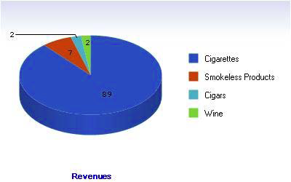
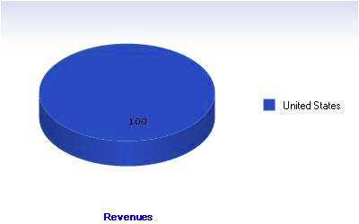
Business & Geographic segment
Business segment Geographic segment
The company is primarily engaged in the manufacture and sale of cigarettes and other tobacco products, and operates primarily in the US.
Source: Thomson Reuters

Slide 42
Industry analysis:
Defensive and sales growth
Barriers to entry
Cigarette industry has a higher barriers to entry, less competition once it has established monopoly position
Sales growth in cigarette
Relatively resistant to macroeconomics events
Tobacco’s has been perceived as “affordable indulgence” among smokers
Demand growth in cigars and smokeless
Cigars have become fashion accessories and are highly popular among the upper-income class.
U.S. Cigarette Consumption Falls 14% Since 2008, but Prices Rise 30%

Slide 43
Company analysis: business strengths
Revenue generators
Established brand allows Altria to consolidate its current presence and penetrate new market
Acquisition of UST and John Middleton resulted in strong performance
Cost management
Continuously focused on cost reduction and manufacturing optimization program in the recent years.
Generated approximately $300 million in UST integration cost savings as of December 2010
Strong market position gives tremendous bargaining power
Effective cost savings will continue to increase profitability
Capture new trends through innovation and acquisition
Altria Services will develop new products to capture more consumers
Acquisition of UST has led to brand value leverage and market penetration in smokeless tobacco products.

Slide 44
Company analysis: financial assessment
The company’s return on invested capital has averaged 22% over the past five years. There’s a steady earning growth and the company is able to slightly increase margins through effective cost control:
Source: Bloomberg

Slide 45
Valuation: Trading comps
Altria Group is trading at multiples in line with its peers (Reynolds American Inc. and Lorillard, Inc.). The price target for MO is $39.00 at 16x projected 2012 EPS.
Source: Bloomberg

Slide 46
Risks and Mitigants
Key downside risks include:
1) Continued FDA regulations. But MO appears increasingly focused on increasing its agility and preparedness around FDA regulation, a trend which appears to be supported by the selection of Marty Barrington (a former General Counsel at PM USA) as incoming CEO and the company’s partnership with Okono A/S.
2) Any large-scale unforeseen adverse tobacco litigation development
3) Potential state tax hikes (owing to large deficits and unfunded pensions). The recent trend has been for minimal state tax hikes with only two states raising taxes and one state actually reducing the cigarette tax in 2011.
4) Little exposure to the global tobacco industry. Primary focus on US market, high single market risk.

Slide 47
Conclusion
Recommend buying
1) industry advantages
- defensive
- high entry barriers
2) business strength
- strong market position
- new market penetration
- effective cost management
3) attractive valuation:
- high dividend yield (6%)
- implied undervalue

Slide 48

SanDisk
Investment Thesis
February 2011
Harshita Rawat | hrawat.mba2013@london.edu

Slide 49
Introduction
Company Background
SanDisk designs, manufactures and packages NAND flash based removable cards, embedded storage, USB drives, SSD and enterprise storage solutions
Key statistics:
  Market cap: USD 11.4 bln
  Net Cash Balance : USD 3.7 bln
  Last Close : USD 48, EPS : USD 4.65
  PE – 10.3, EV/EBIT – 6.5
Agenda for Discussion
Industry overview
Company overview
Financial and Operating Performance
Key Valuation Drivers
Conclusion

Slide 50
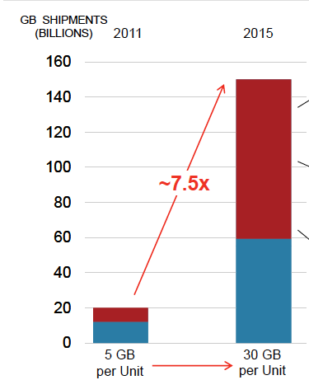
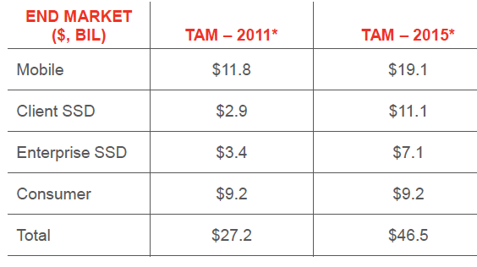
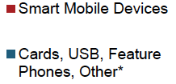
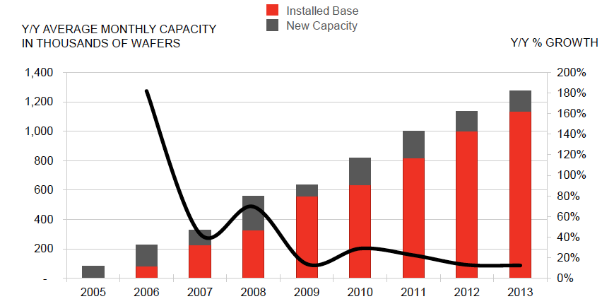
Industry Poised for Growth
Smart Mobile Devices Driving Demand for NAND
Source: SanDisk Analyst Presentation
Industry Snapshot
Will the Overcapacity Continue?
Major players are Intel-Micron alliance, Samsung, SanDisk-Toshiba JV and Hynix
Industry barriers to entry include complex NAND technology, licensing, patents and contracts with chip set manufacturers.
Ability to build controllers for the memory key to shorter lead times for new technologies.
In 2011, amidst fear of supply constraints after the Japan Earthquake, global manufacturers ramped up supply. Supply from Japan, however, came back on track in record time. This led to an overcapacity leading to a worse than expected 34% decline in the Average Selling Price per gigabyte and a tough pricing environment for NAND manufactures.
Source: SanDisk Analyst Presentation
Smart Mobile Devices Leading Growth Leading Industry Growth

Slide 51
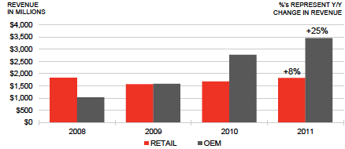
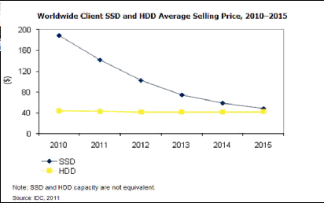
Strong Company Powered By Sound Management
Competitive Advantage Through Technology
Changing Product Mix
Strong Relationships with Tier 1 OEMS
Cost Leadership
Technology Pioneer (eg 19nm NAND). Working on 3D Nand
Through technology leadership, SanDisk defended operating margins of 25% in the last 2.5 years. Cost per gigabyte improved by 31% despite the strong yen.
The vertically integrated business model enables the technology to be on the market at a remarkable pace
Differentiates through proprietary controllers along with firmware architecture
Source: SanDisk Analyst Presentation
OEM segment is occupying increasing revenue share
Owing to its recent acquisitions, SanDisk would derive 25% of its revenue from SSD in 2014 vs. 3% in 2011.
Does Cloud really hurt SanDisk’s business? While retail suffers, new acquisition will enable caching solution used in servers
Is low NAND pricing really bad for SanDisk?
Led by Visionary Founder
Positioning by Management
Develop capability for SSD
Increasing focus on OEM
Reduce the reliance on non captive supply
Company has repositioned itself to derive revenues from new product mix and cost effeciency

Slide 52
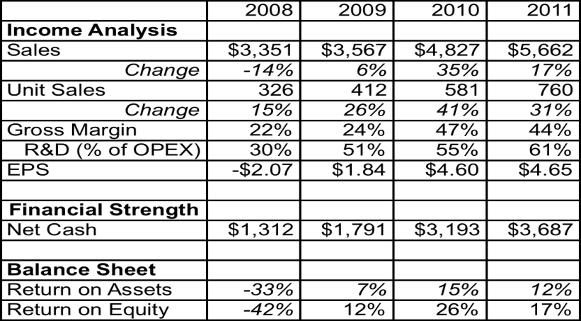
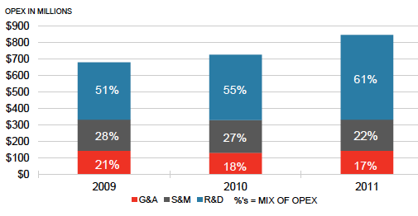
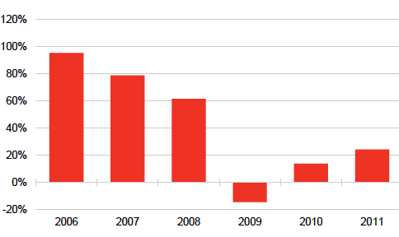
Growing Revenues, Defensible Margins
Revenue Growth, Defensible Margins Achieved Through Investments in Technology
Solid balance sheet will allow SanDisk to make more aggressive network investments in the future
In FY 2011, revenue and Operating income grew 17% and 4.7%, respectively. Free cash flow yield was 7.58%.
SanDisk has a solid balance sheet that will allow it to make more aggressive investments in the future.
Cost Savings Outperformed price declines by 3.7%
3.3% reduction of Gross Margin vs. 2010 was the result of 3.9% unfavourable movement in Yen
Return on assets computed on total assets including cash
Increasing R&D Spending
Strong Operational Performance
Captive Supply Growth YoY
Source:
SanDisk’s Annual Report
Source:SanDisk’s Annual Report
Cash conversion cycle improved from 85 days to 72 days in the last 2 yrs.
To minimized operational risks, SanDisk has also been increasing captive supply and reducing dependence on third party foundries
14% of R&D expense went to investment in new technologies vs. 8% for 2010.
Strong Revenue Growth Accompanied by Defensible Margins

Slide 53
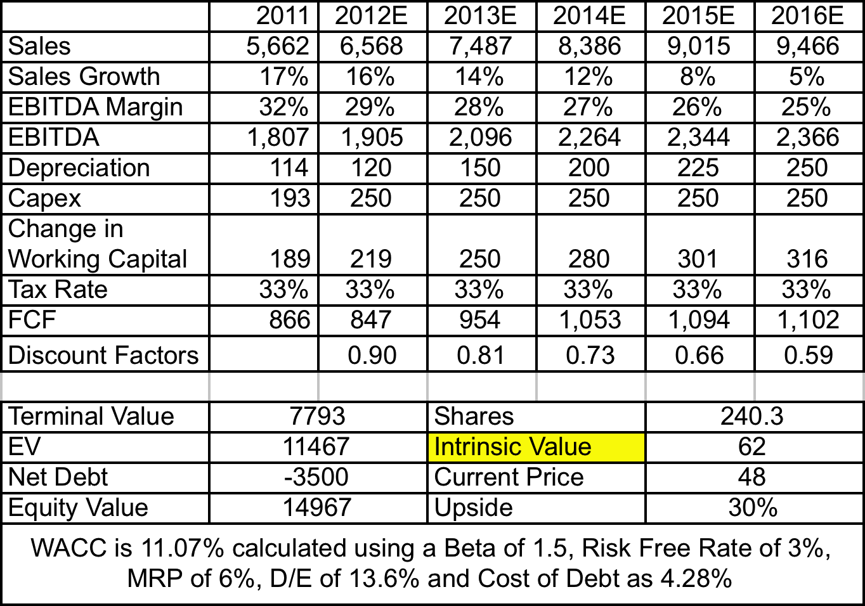
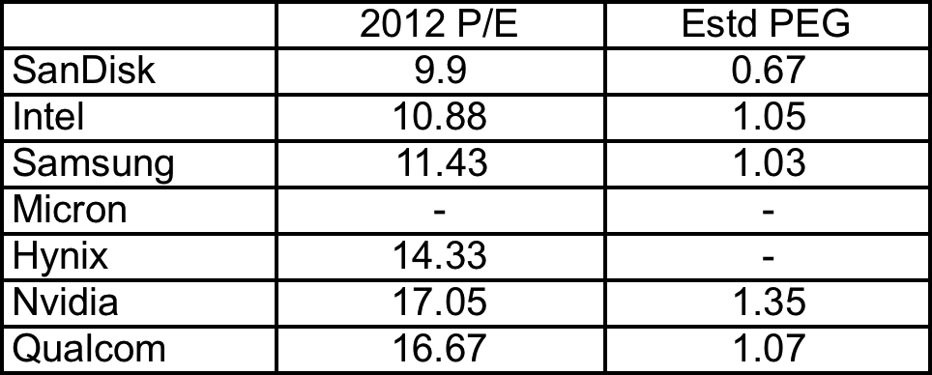
DCF Suggests 30% Price Upside
Valuation Drivers
Valuation
DCF implies a fair value of $62 vs. the current price of $48
CAGR (2011-2015) revenue growth rate of 12% is less than the CAGR projected for industry as I modelled the fact that SanDisk will not maintain its current market share in the growing industry
Changing product mix and technology invested in cost reductions will help the company defend around 25% EBITDA margin.
Terminal Value is estimated using FCF growth of 2.5%.
Terminal Values implies exit EV/EBITDA multiple of 5.5x
A meeting with management should provide more guidance to accurately forecast Capex
Lowest PEG vs. Semiconductor Companies
Risks
Cash conversion cycle improved from 85 days to 72 days in the last 2 yrs.
Inability to perform cost reductions compared to decline in NAND pricing Increasing reliance on non captive supply
A new technology/natural disaster that can disrupt the demand for NAND flash;
Stronger Yen
Underpriced Relative to Intrinsic Value of $62

Slide 54
Attractive Investment Opportunity
Conclusions
Despite the attractive growth prospects, SanDisk’s stock is down 7.5% in the last one year due to fears that it cannot defend margins amidst declining NAND prices.
Investors are underplaying the growth prospects of SanDisk’s core markets and the company’s ability to deliver cost reductions through technology leadership.
Run by strong management, SanDisk has repositioned itself to capture the growing Smartphone, SSD and Tablet market.
Overall I believe that at a price of $48, the stock is undervalued relative to its intrinsic value of $62.

Slide 55
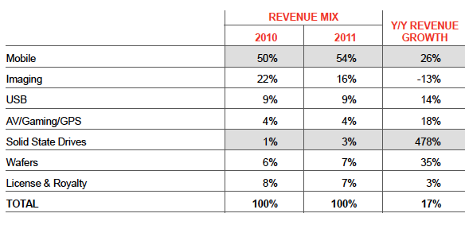
Appendix 1: Revenue Mix and Bit Data
Revenue Mix
2011 Unit sales of 760 million
iNand qualified for 50% tablets and 60% android

Slide 56
Cheniere Energy, Inc.
Stock Pitch Competition
by Stelios Fragos
February 23rd, 2012

Slide 57
Cheniere - Business Overview
Cheniere Energy, Inc. (NYSE AMEX:LNG¹ is looking to export Liquefied Natural Gas ("LNG") from the US Gulf region.
Initially, the company planned on importing LNG but subsequently changed its business plan and is developing a liquefaction facility at Sabine Pass, in Louisiana.
  4 LNG trains: 18 mtpa capacity;
  Received all major regulatory approvals except for FERC.
All 4 trains are contracted:
  20 year contracts;
  Reputable investment-grade counterparties;
  Take-or-pay contracts.
Note⁽¹⁾: Cheniere and Company to be used interchangeably throughout the presentation.

Slide 58
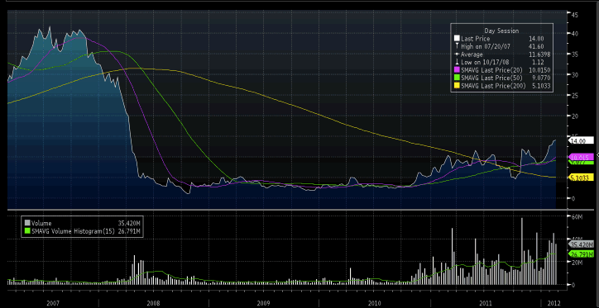
Yes, investors have been burned before, but the business has been significantly de-risked
Company share price collapsed following the decrease in US natural gas prices.
Cheniere refocused its strategy to take advantage of new global natural gas pricing dynamics
Stock has been building momentum on the back of the following catalysts:
  DoE Approval in May 2011
  Secured contracts for all 4 trains (2011-Q1 2012)
  Initiation of coverage (CS in Jan ‘12)
Growth interest in LNG market globally could drive M&A activity
  Cheniere is an attractive M&A target

Slide 59
3-pillar Investment Approach
Assessing the Business
Dynamics and attractiveness of LNG exports from the US Gulf Region
Identify Cheniere’s competitive advantages
Risks / Concerns
Identify inherent risks to the business and downside potential
Assess mitigating factors
Valuation
Deconstruct complicated corporate structure
Overcome valuation challenges (i.e. lack of peers) and identify best valuation method
Quantify upside / downside

Slide 60
Investment Thesis - Strengths
Exposure to the LNG Market without the underlying commodity risk.
Project viability defined & business has been de-risked.
Long-term cash flow visibility from signed contracts.
First mover advantage following DoE approval.
Low cost positioning compared to peers.
Access to vast low cost supply source.
Location provides optionality.
Notes:
Exposure to the LNG Market without the underlying commodity risk. Cheniere is insulated from commodity risk due to its long-term take-or-pay contracts, while through its C-Corp structure it double-dips both through dividends (more tax-efficient) as an LP and through IDRs as a GP from CQP.
Project Viability Defined. Cheniere has received all the necessary approvals, signed commercial contracts for 16mtpa and an EPC contract for the construction of the first two liquefaction trains at Sabine Pass. Only pending approval is the FERC one and once it is received the project will become further de-risked.
Long-term cash flow visibility from signed contracts. Cheniere has signed fixed-price 20-year take-or-pay contracts with investment grade rated counterparties: BG (5.5mtpa), Gail India (3.5mpta), Gas Natural Fenosa (3.5mpta) and Kogas (3.5mpta).
First Mover Advantage: Cheniere is the only company currently authorized to export to both free trade agreement and non-free trade agreement countries following the Department of Energy (DOE) approval in May 2011. DOE will only approve further applications following the completion of studies in Q1 2012, giving Cheniere a lead of at least six months.
Low Cost Positioning. The liquefaction project is expected at $500-$550tpa compared to greenfield projects costing $1000tpa.
Access to Vast Low Cost Supply Source. Cheniere’s has access to the huge North American natural gas reserves, which currently trade at $2.79 compared to European and Japanese prices ranging from $8-12BTU. At these price levels, exporting to Europe and Asia is financially sustainable and attractive.
Location Provides Optionality. Cheniere has the unique advantage of having viable export options to both Asia and Europe giving it access to a range of customers and the opportunity to utilize its wedge capacity fully.

Slide 61
Key Business Plan Milestones Reached

Slide 62
Investment Thesis - Risks & Concerns
Secure financing for Phases I & II.
Pending FERC approval.
Project execution.
North America as a sustainable source of LNG exports.
Competing projects in North America.
Notes:
Secure Financing. The key risk for Cheniere is the cost of financing required, specifically the equity portion. Phase I of Sabine Pass (trains 1 & 2) will require $4.5-$5.0b, expected to be financed with $2b in equity (raised at CQP level) and $3b of debt project financing. In the last 3 quarters, the equity story has been strengthened significantly and the commercial viability has been defined. Analysts expect CQP to raise $2b of equity by issuing units at a discount of 30-35% to current levels.
FERC Approval. The last of regulatory approvals required. According Cheniere, this should be received within Q1 2012.
Project Execution. Moving on to the construction phase, the key risks are delays and non-budgeted costs, which may affect the company’s secured contracts. This is mitigated through the contractual arrangement with Bechtel, since Bechtel has a long track record of LNG facilities construction and is also responsible for additional costs should they arise.
North America as a sustainable source of LNG exports. If the spread between Europe/Asia and North America closes, then the attractiveness of LNG exports from North America may decrease. This is mitigated by Cheniere’s long-term take-or-pay contracts.
Competing Projects. There are two competing projects in North America, Kitimat and Cove Point, located in Western Canada and the US East coast respectively. While Kitimat has to Asia and Cove Point to Europe, Cheniere’s Sabine Pass can serve both allowing it to mitigate transportation costs.
High Short Interest. The short interest position of Cheniere is at 11.88% currently, potentially increasing the volatility of the stock.

Slide 63
Significant Financing Requirements

Slide 64
Sources of Funds
Phase I – Trains 1&2
  Debt - Project Finance Market:
    c. $3b at Libor + 300bps (swapped)
    c. $1.2b of EBITDA for coverage
  Equity Options:
    c. $2bn
    CQP common units
    CQP subordinated units
    LNG shares
Phase II Trains 3&4
  Debt – Term Loans/Bonds:
    c. $1.4b of EBITDA for coverage
  Equity
    c. $2bn
Trains 1-4 total expected EBITDA c. $2.7b

Slide 65
Valuation
Valuation Challenges:
  Capture true valuation impact in the outer years:
    Contracted revenue increases by c. $330m per year once all trains come online;
    EBITDA of $2.7bn after 2018.
  No peers for multiples valuation.
Bottom-up model
  Liquefaction module;
  Financial module w/ sensitivity analysis;
  Financing module w/ scenario analysis;
  Valuation based on:
    Dividend yield analysis;
    Sum-of-the-parts of Cheniere’s holdings.

Slide 66
Valuation (Cont’d)
LNG cash flow per share (2018 onwards) is $6.4 using PIK financing
  More conservative, as cash flow per share drops from $7.7 and compensates CQP unit holders for near term dividend dilution
Given steady nature of cash flows per share, applying a dividend-yield of 8% to its 2018 dividend of $6.40,yields $45 per share with a discount factor of 10%.
Conservative approach given energy/midstream MLPs with similarly stable cash flows trade on dividend yields of 4-7%.
Sum-of the-parts of Cheniere’s was also used as an alternative methodology returning a range of $40-$55
  Includes valuation of Common Units and Subordinated Units Distributions

Slide 67
So, why does this trade exist?
Valuation / Investment Risk
Lack of Coverage
Investors are having trouble valuing Cheniere:
  Lack of peers;
  C-Corp/MLP complicated structure - market not properly valuing the GP.
Significant downside if:
  FERC blocks application; or
  Cheniere does not succeed in securing financing.
Only Citi and Credit Suisse covering stock:
  CS initiated coverage on January 18th.
Issues with valuation approach of both analysts:
  CS is using “DCF” and is overly conservative in its financing assumptions.
  Citi analyst does not cover MLPs.

Slide 68
Concluding Remarks
Despite Cheniere's complicated corporate structure and inherent challenge in valuation, the Company represents a great long-term trade with significant upside (at least 2-3x its current share price)
Its take-or-pay contracts provide strong visibility and cash flow visibility without the underlying commodity risk
Scarcity value as a direct play on theme of increasing global LNG demand and low cost US LNG
Lastly, it is an attractive takeover target with clear competitive advantages for well-funded US midstream strategic players.

Slide 69
Appendix

Slide 70
Valuation Sensitivity Analysis

Slide 71
Sensitivity Analysis - Operational
Sensitivity table below outlines various operational scenarios:
  $4.5-$5.50 dividend per share range reflecting the unlikely event 1 of the 4 contracting parties does not honour their contract)
  $6.37-$7.75 per share, reflecting financing scenarios
  Sensitivity analysis vs. dividend yield (range reflecting upper part of dividend yields of MLPs 4$-7%)

Slide 72
Sensitivity Analysis - Dividend Yield / Discount Rate

Slide 73
Financing Scenarios: Sensitivity Analysis
Scenarios:
  Base case (2015/2017, no PIK)
  PIK scenario (2012, 2014)
Sensitivity Analysis:

Slide 74
Operations Overview

Slide 75
Contracted Capacity at SPL Sale and Purchase Agreements (SPAs)

Slide 76
Attractive & Sustainable Transportation Costs

Slide 77
Sabine Liquefaction Gas Sources Asset Map

Slide 78
Sabine Pass LNG Terminal Expansion Plan

Slide 79
Group Structure & Debt Breakdown

Slide 80
Complicated Incentive Structure at GP Level
Cheniere owns the GP and the LP of CQP (86.8%).
Cheniere owns 12.0mm common units in CQP,135.4mm subordinated units and 3.4mm general partner units.
Currently CQP only pays the MQD to common unit holders.
Subordinated unit holders are not receiving distributions.
The general partner manages CQP’s businesses, and through its ownership of incentive distribution rights, is incented to grow CQP’s distributions. Distribution target levels were set at CQP’s formation:

Slide 81
Market Dynamics

Slide 82
US Natural Gas Market
Notes:
Current market fundamentals in the U.S. – increased production, increased natural gas reserves and lackluster increase in natural gas demand – have created an opportunity to expand into exports – benefitting U.S. economy, creating jobs and reducing balance of trade

Slide 83
Global Petroleum Demand - Stationary Sources
Global oil use totals 19 million b/d (~22%) in stationary sources, such as industrial, power and heating, that could be switched to natural gas: equivalent to 100+ Bcf/d natural gas demand
Source: PIRA Energy Group, “The Potential for Natural Gas Substitution of Stationary Petroleum Demand”, January 2010

Slide 84
Global LNG Market

Slide 85
Firm Liquefaction Capacity Additions

Slide 86
North America Onshore Receiving Terminals

Slide 87
Agenda
1 | About the Stock Pitch Competition
2 | Student Investment Fund update
3 | Competition’s Judges
4 | Stock Pitch Finalists
5 | Student Presentations
6 | Judges’ final decision

Slide 88
Judges’ final decision
And the winner is…

Slide 89
Thanks for participating!
Next Stock Pitch Competition
Autumn 2012
Please, join us at Sainsbury’s lower ground floor to celebrate

